Slide 1

Tourism as a Tool of Relaxation
How Travel Helps Improve Mental Health and Work-Life Balance
Wellness & Mental Health
2025
DERE MARIAM KEHINDE
Stress Relief Through Travel

Slide 2

Why This Matters Now
Overwhelming Routines
Health Impact
Chronic stress affects our physical and mental well-being significantly
Life and work can be overwhelming due to constant routines and endless deadlines
Proven Solution
Tourism offers an effective, accessible way to relieve stress and restore balance

Slide 3

Understanding Stress
The Modern Challenge

Slide 4

Daily Pressures Facing Nigerians
Economic Strain
Urban Congestion
Inflation at 33.7% (NBS, April 2024) drives up cost of living exponentially. Basic necessities become luxury items, forcing families to work longer hours just to maintain previous living standards.
30 hours weekly in traffic for average Lagosians represents lost time, increased fuel costs, and chronic frustration. This daily ordeal creates cumulative stress that affects mental and physical health.
Food prices increased 40% year-over-year
Average commute: 3-4 hours daily
Transportation costs doubled in major cities
Increased road rage incidents
Reduced family time and personal activities
Housing affordability crisis intensifies
Work-Life Imbalance
10–12-hour workdays are common across sectors, with limited vacation time. The "hustle culture" mentality prevents proper rest and recovery, leading to burnout and health complications.
Limited annual leave utilization
Weekend work expectations
Inadequate mental health support

Slide 5
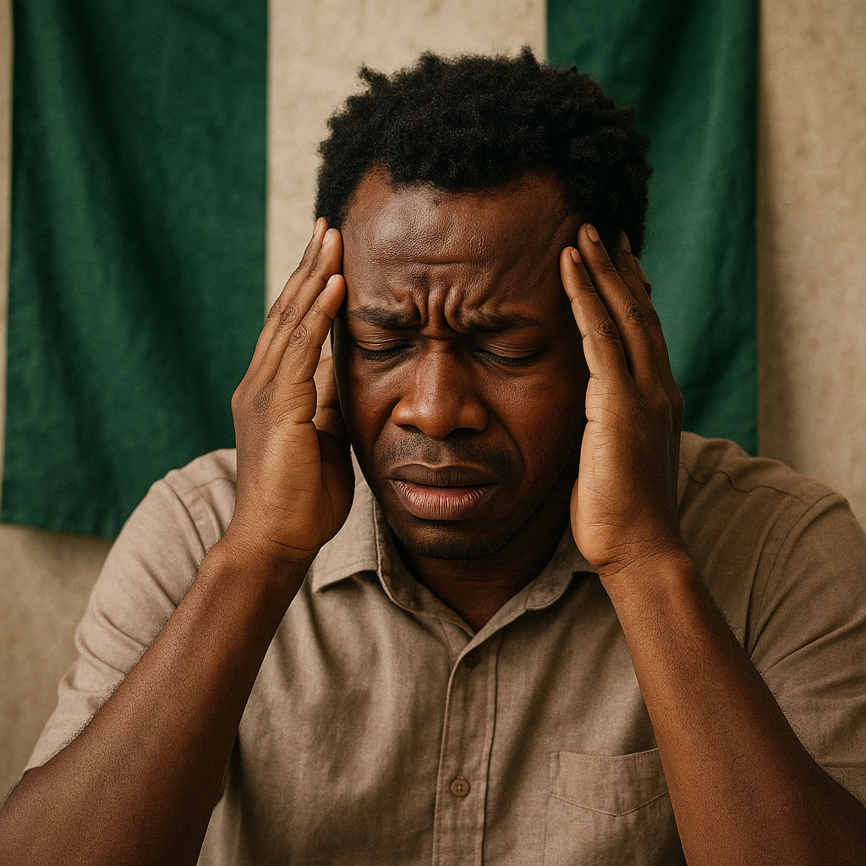

The Human Cost of Chronic Stress
Physical Health Deterioration
Mental Health Crisis
Chronic stress triggers a cascade of physiological responses that damage the body over time. Hypertension rates in Nigeria have increased 40% in the past decade, with stress being a primary contributing factor.
20-30% of Nigerians suffer from mental illness according to WHO estimates, with anxiety and depression being most prevalent. The stigma surrounding mental health prevents many from seeking help.
Key impacts: Cardiovascular disease, diabetes, weakened immune system, digestive issues, and premature aging. The body's constant fight-or-flight response exhausts vital systems.
Manifestations: Persistent worry, sleep disorders, irritability, difficulty concentrating, and social withdrawal. These symptoms create a vicious cycle of reduced productivity and increased stress.
Societal Impact
Stress doesn't exist in isolation—it ripples through families, communities, and the economy. Stressed individuals struggle with relationships, parenting, and civic engagement, weakening social fabric.
Broader effects: Increased domestic violence, child behavioral problems, reduced community participation, and economic productivity losses estimated at billions annually.
Critical Need: Without intervention, stress-related health issues will continue escalating, placing unsustainable pressure on Nigeria's healthcare system and economic growth.

Slide 6





What's Causing Our Stress?
Heavy Workload
Poor Work-Life Balance
Family Obligations
Excessive deadlines and demanding schedules create constant pressure
Difficulty separating professional and personal time
Managing household responsibilities alongside career demands
Financial Pressure
Lack of Recreation
Economic concerns and financial planning stress
Insufficient time for relaxation and personal enjoyment

Slide 7
Tourism as Solution
The Power of Travel

Slide 8


What Is Tourism?
Core Definition
Traveling for leisure, recreation, or business purposes
Cultural Exploration
Discovering new environments, cultures, and experiences
Diverse Types
Ecotourism, wellness tourism, adventure travel, cultural trips, and more

Slide 9




How Tourism Transforms Stress
Escape Routine
Mental Refresh
Breaking away from familiar stressful environments
Providing emotional relief and mental reset
Social Connection
Mood Enhancement
Strengthening bonds and finding spiritual peace
Boosting happiness while reducing anxiety levels

Slide 10
The Science Behind It
Proven Mental Health Benefits

Slide 11
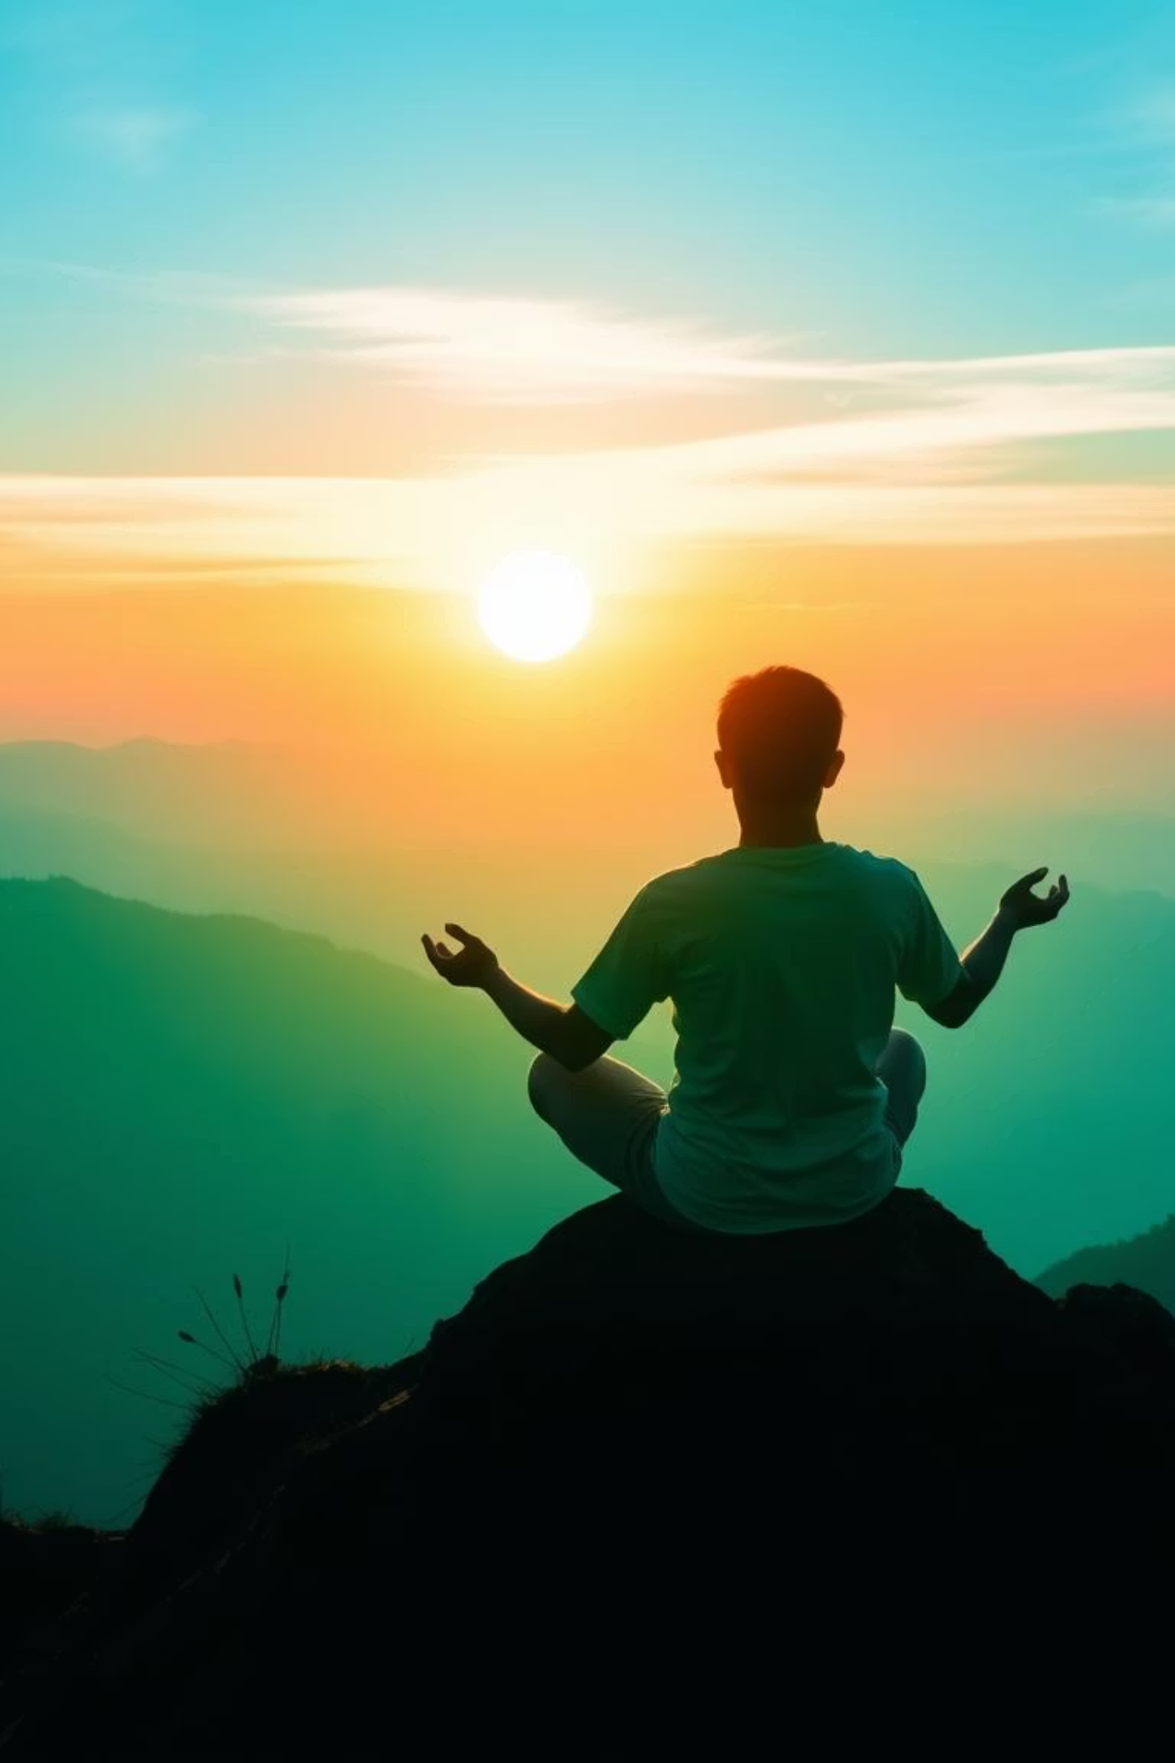




Psychological Benefits
Happy Hormones
Mindfulness
Boosts dopamine and serotonin production naturally
Encourages present-moment awareness and meditation
Burnout Prevention
Enhanced Productivity
Reduces risk of depression and workplace burnout
Improves focus and work performance upon return

Slide 12
Types of Relaxing Tourism
Find Your Perfect Escape

Slide 13
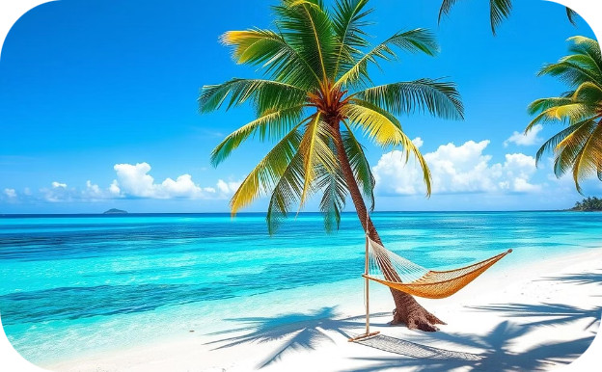
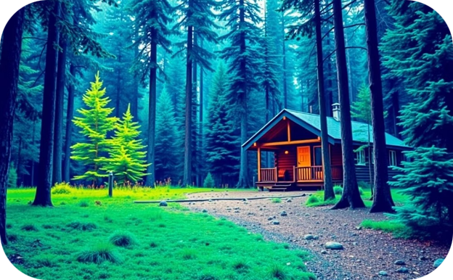
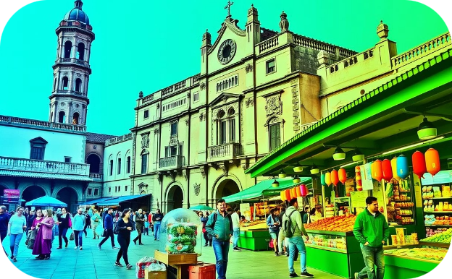
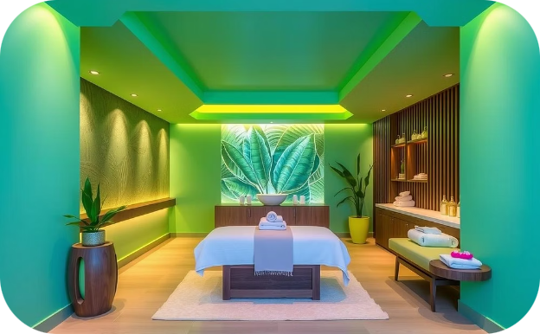

Relaxing Tourism Options
Beach Holidays
Nature Retreats
Cultural Trips
Sun, sand, and sea for ultimate relaxation
Reconnecting with natural environments
Exploring history and local traditions
Spa & Wellness
Staycations
Focused health and wellness experiences
Relaxing close to home with local exploration

Slide 14

Real Impact Stories
"A week in Kigali and Nairobi helped me reset mentally. I came back more focused and grateful."
Dere Kehinde Mariam
Travel experiences create lasting positive changes in mental health and work performance. The benefits extend far beyond the vacation itself.

Slide 15
Making It Work
Support Systems & Practical Tips

Slide 16
How Employers Can Support
1
Encourage Leave Usage
Actively promote vacation time and mental health days
2
Promote Work-Life Balance
Set clear boundaries and respect personal time
3
Offer Travel Incentives
Provide wellness stipends or travel benefits
4
Respect Vacation Boundaries
Avoid contacting employees during their time off

Slide 17





Tips for Relaxing Travel
Plan Ahead
Disconnect from Work
Reduce stress by organizing details in advance
Set clear boundaries and turn off notifications
Choose Peaceful Destinations
Pack Light & Stay Flexible
Embrace spontaneity and reduce travel stress
Select locations that promote relaxation and calm

Slide 18

The Investment in Your Well-being
78%
68%
Report Better Mental Health
Increased Productivity
After taking regular vacations
Upon returning to work
40%
Reduced Burnout Risk
With regular travel breaks
Tourism isn't just a luxury—it's essential for maintaining mental health and work-life balance in our demanding world.

Slide 19

Your Journey to Better Mental Health Starts Now
Take the first step toward stress relief and renewed energy

Slide 20
Ready to Transform Your Well-being?
Start Planning
Choose your ideal relaxing destination today
Set Boundaries
Disconnect from work and embrace the experience
Make It Regular
Schedule regular breaks for sustained mental health
Remember: Taking care of your mental health isn't selfish—it's essential.
Your well-being impacts every aspect of your life. Invest in yourself through the transformative power of travel.

Slide 21
THANK YOU VERY MUCH FOR LISTENING

